Slide 1
Data Link Layer
Vidhi Pandya
Assistant Professor
CSE Department
DEPSTAR
CHARUSAT

Slide 2
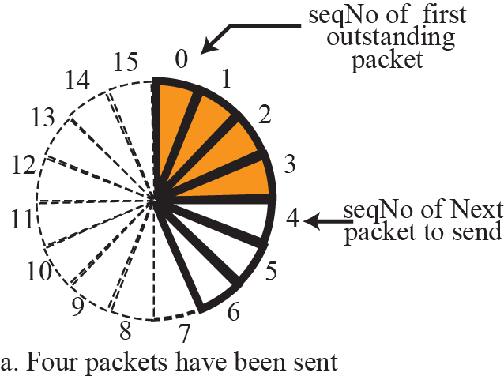
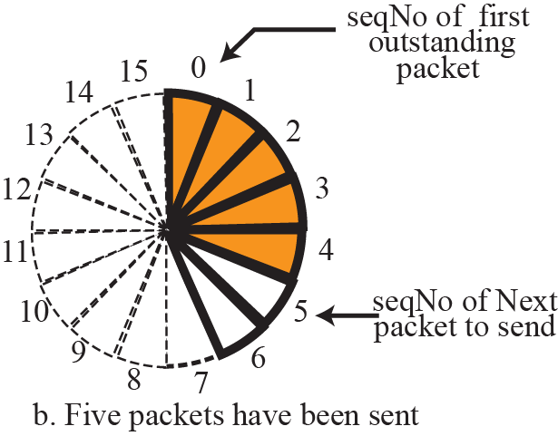
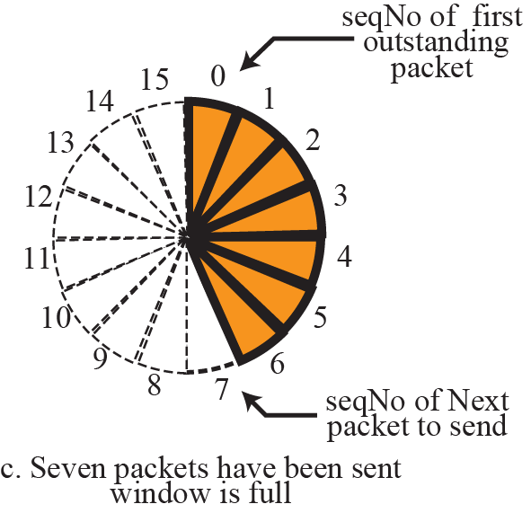
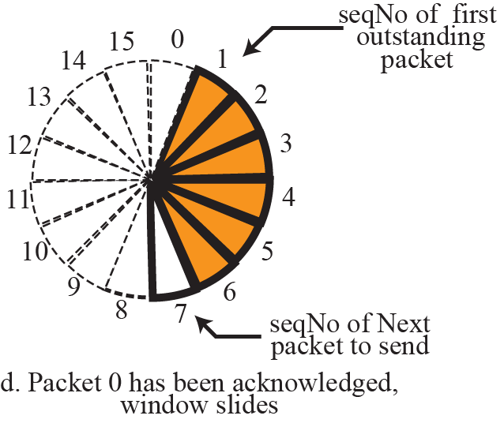
Figure 3.11 Sliding window in circular format

Slide 3
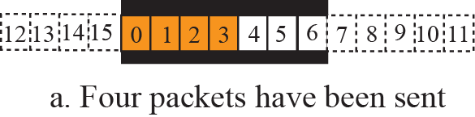
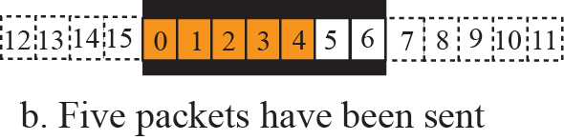
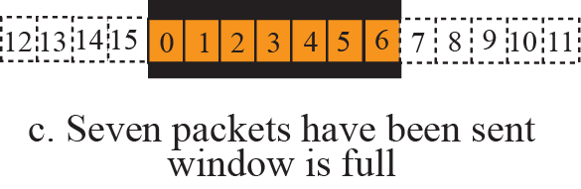
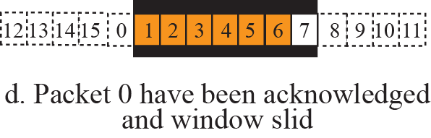
Figure 3.12 Sliding window in linear format

Slide 4
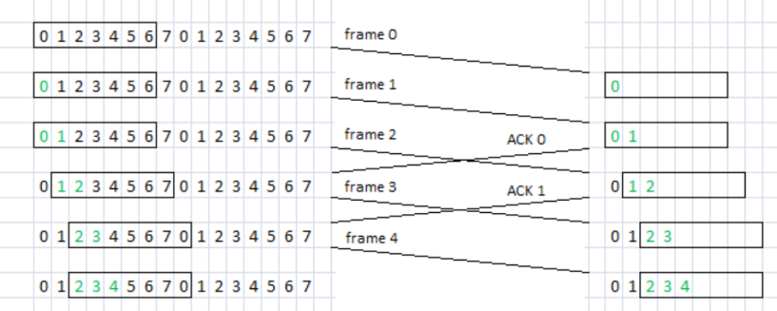
Sliding Window Protocols – Sending Window and Receiving Window
The sender maintains a set of sequence numbers corresponding to frames it is permitted to send (sending window)
The receiver maintains a set of frames it is permitted to accept (receiving window)

Slide 5
PROTOCOLS
Simple Protocol
Stop-and-Wait Protocol
Go-Back-N Protocol
Selective-Repeat Protocol
Bidirectional Protocols: Piggybacking

Slide 6
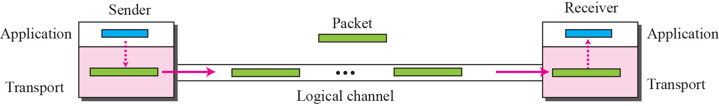
Figure 3.16 Simple protocol
Our first protocol is a simple connectionless protocol with neither flow nor error control.

Slide 7
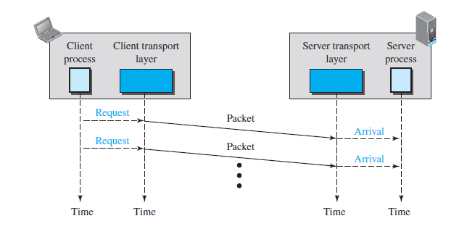
Example
Figure 3.18 shows an example of communication using this protocol. It is very simple. The sender sends packets one after another without even thinking about the receiver.

Slide 8
Stop-and-Wait Protocol
connection-oriented protocol
both flow and error control
Both the sender and the receiver use a sliding window of size 1.
The sender sends one packet at a time and waits for an acknowledgment before sending the next one.
To detect corrupted packets – add checksum
Sender starts a timer

Slide 9
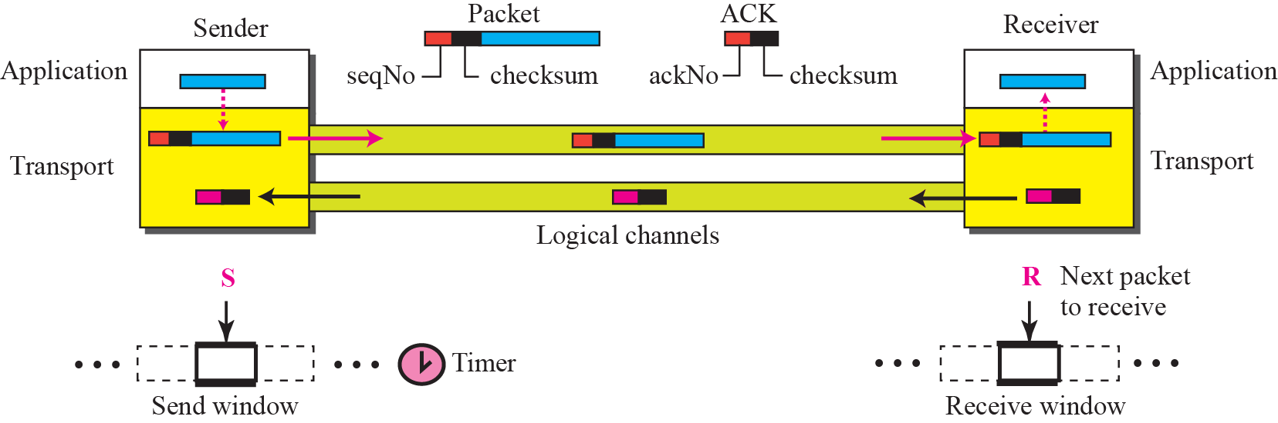
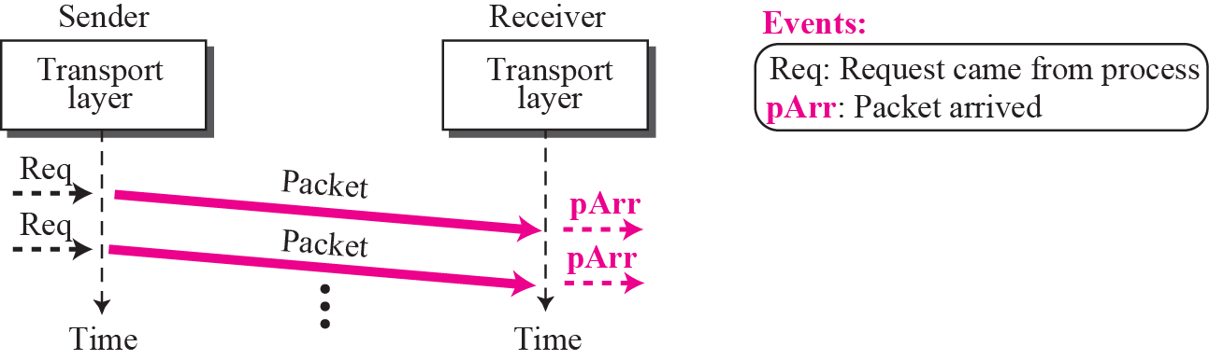
Figure 3.19 Stop-and-wait protocol

Slide 10

Note
In Stop-and-Wait protocol, flow
control is achieved by forcing the sender to wait for an acknowledgment, and error control is achieved by discarding corrupted packets and letting the sender resend unacknowledged packets when the timer expires.

Slide 11
Note
In the Stop-and-Wait protocol, we can use a 1-bit field to number the packets. The sequence numbers are based on modulo-2 arithmetic.

Slide 12
Note
In the Stop-and-Wait protocol, the acknowledgment number always announces in modulo-2 arithmetic the sequence number of the next packet expected.

Slide 13
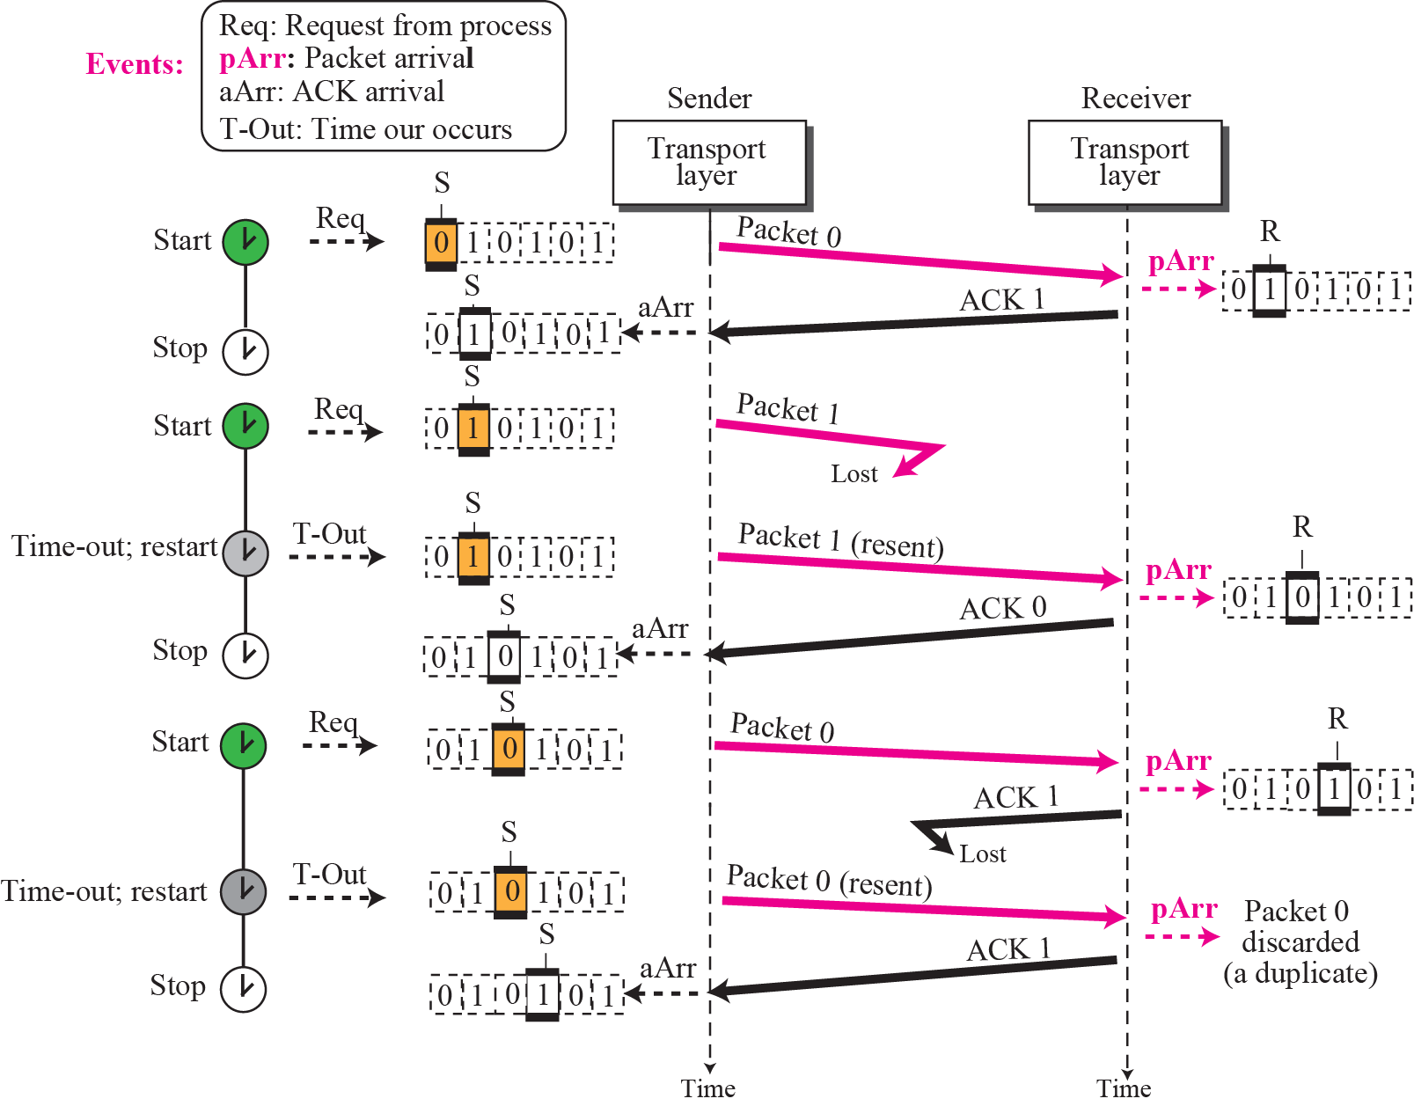
Figure 3.21

Slide 14
Go-Back-N Protocol (GBN)
To improve the efficiency of transmission (to fill the pipe), multiple packets must be in transition while the sender is waiting for acknowledgment.
The key to Go-back-N is that we can send several packets before receiving acknowledgments, but the receiver can only buffer one packet.

Slide 15
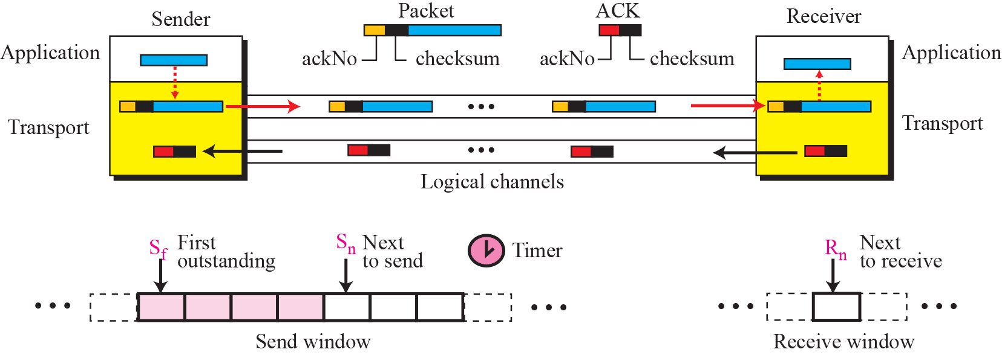
Figure 3.22 Go-Back-N protocol

Slide 16
Note
In the Go-Back-N Protocol, the sequence numbers are modulo 2^{m}, where m is the size of the sequence number
field in bits.

Slide 17
Note
In the Go-Back-N protocol, the acknowledgment number is
cumulative and defines the sequence number of the next packet
expected to arrive.

Slide 18
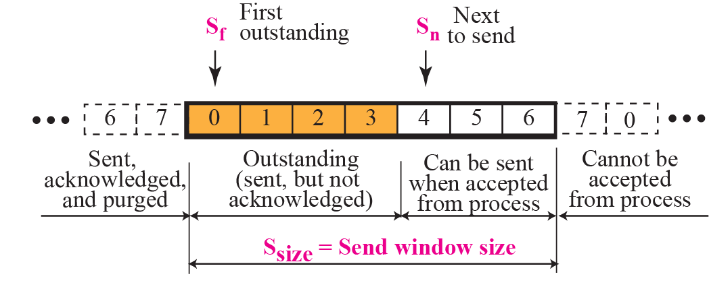
Figure 3.23 Send window for Go-Back-N

Slide 19
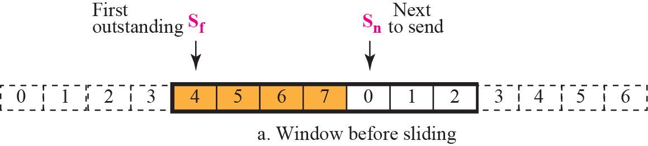
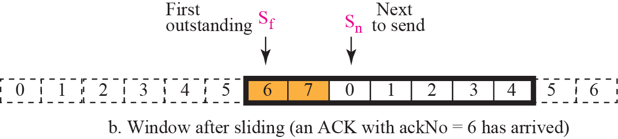
Figure 3.24 Sliding the send window

Slide 20
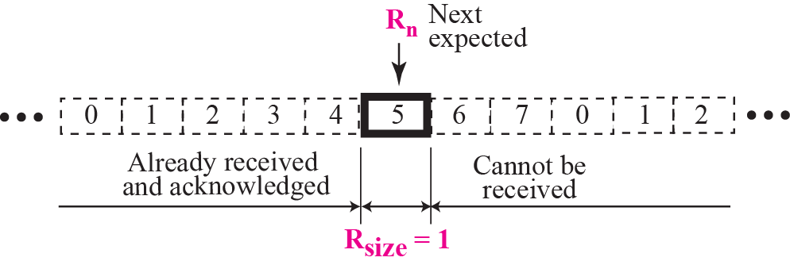
Figure 3.25 Receive window for Go-Back-N

Slide 21
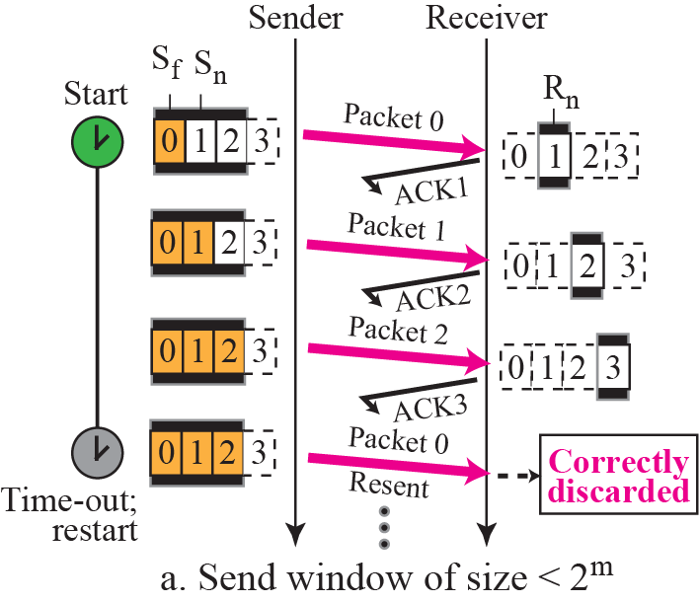
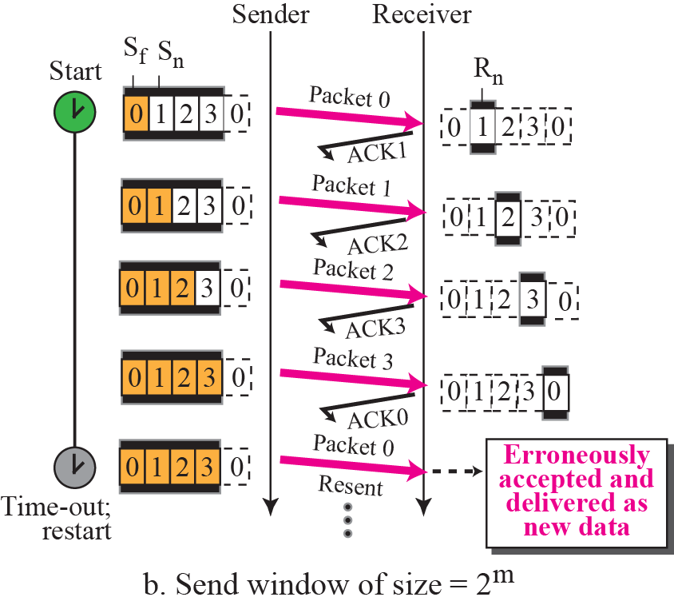
Figure 3.27 Send window size for Go-Back-N

Slide 22

Note

Slide 23
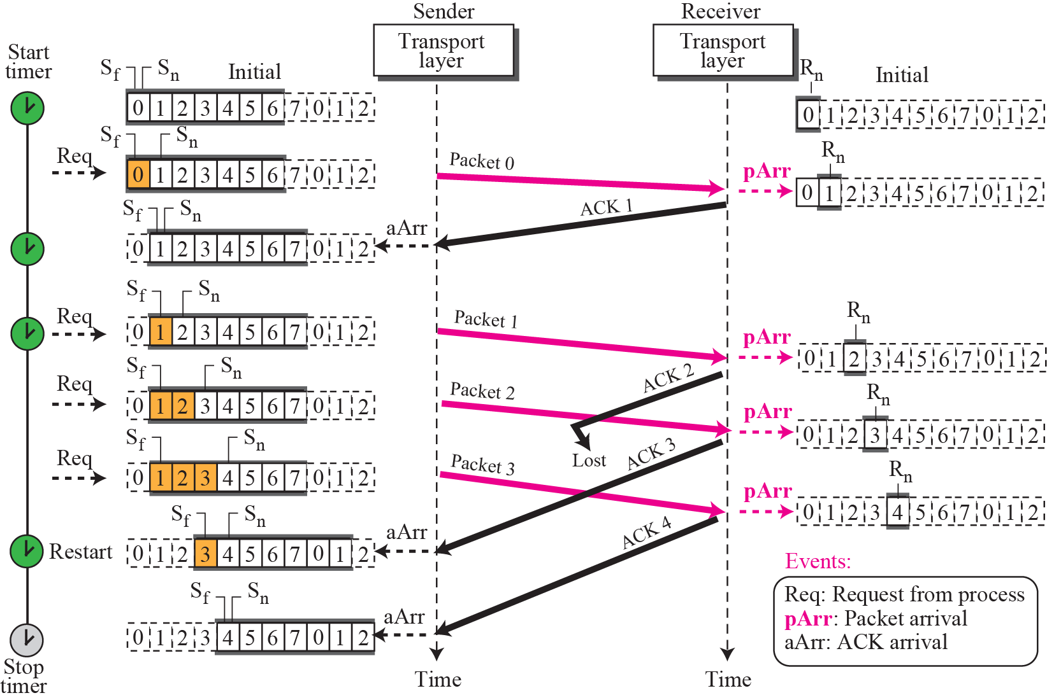
Figure 3.28

Slide 24
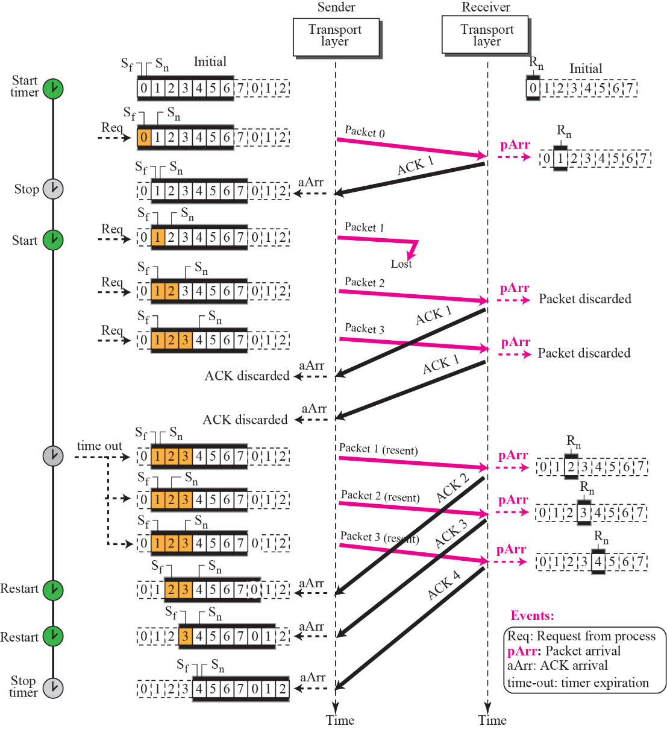
Figure 3.29

Slide 25
Selective-Repeat Protocol
The Go-Back-N protocol simplifies the process at the receiver. The receiver keeps track of only one variable, and there is no need to buffer out-of-order packets; they are simply discarded.
Inefficient – chances to lost maximum packets.
Another protocol, called the Selective-Repeat (SR) protocol, has been devised, which, as the name implies, resends only selective packets.

Slide 26
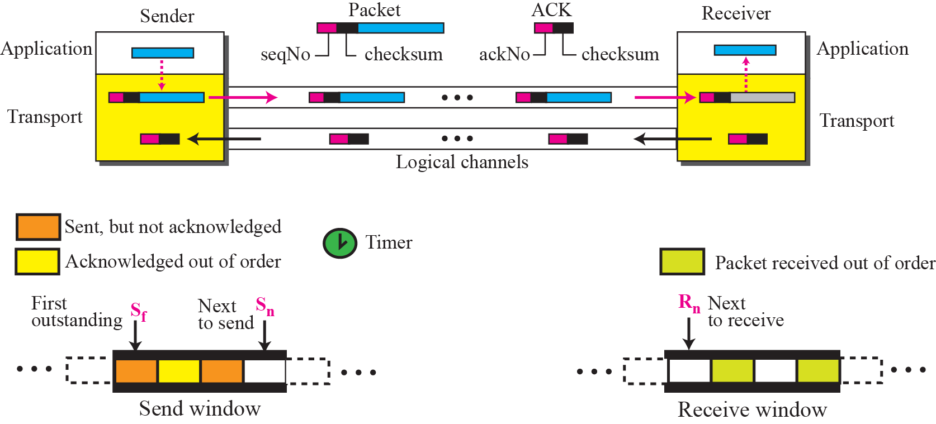
Figure 3.30 Outline of Selective-Repeat

Slide 27
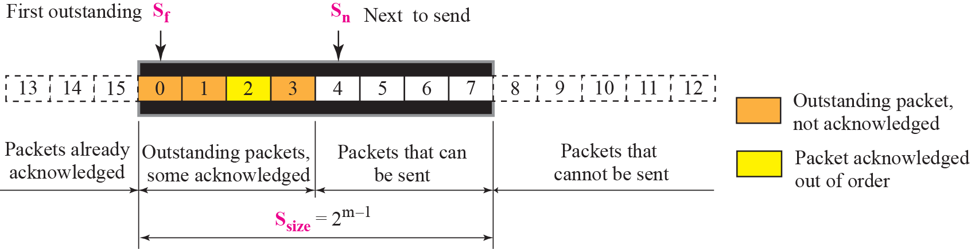
Figure 3.31 Send window for Selective-Repeat protocol

Slide 28
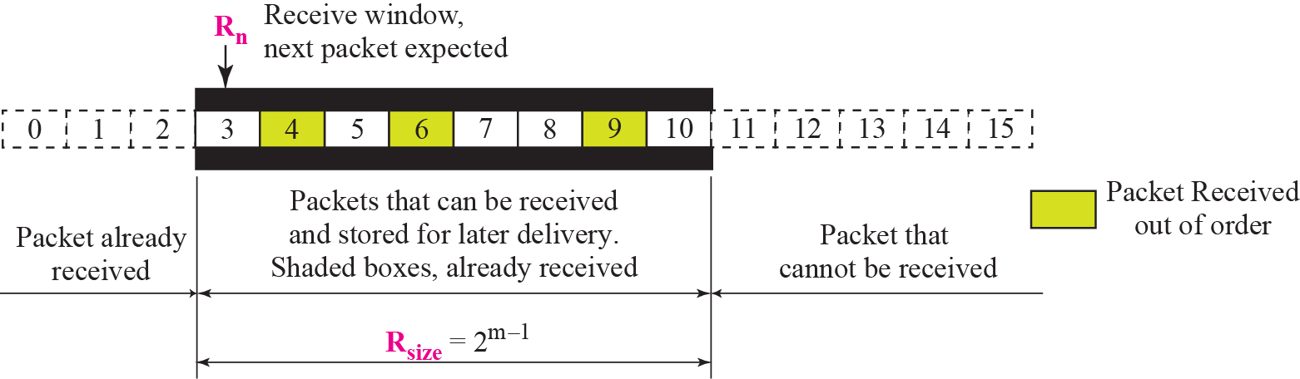
Figure 3.32 Receive window for Selective-Repeat protocol

Slide 29
Note
In the Selective-Repeat protocol, an acknowledgment number defines
the sequence number of the
error-free packet received.

Slide 30
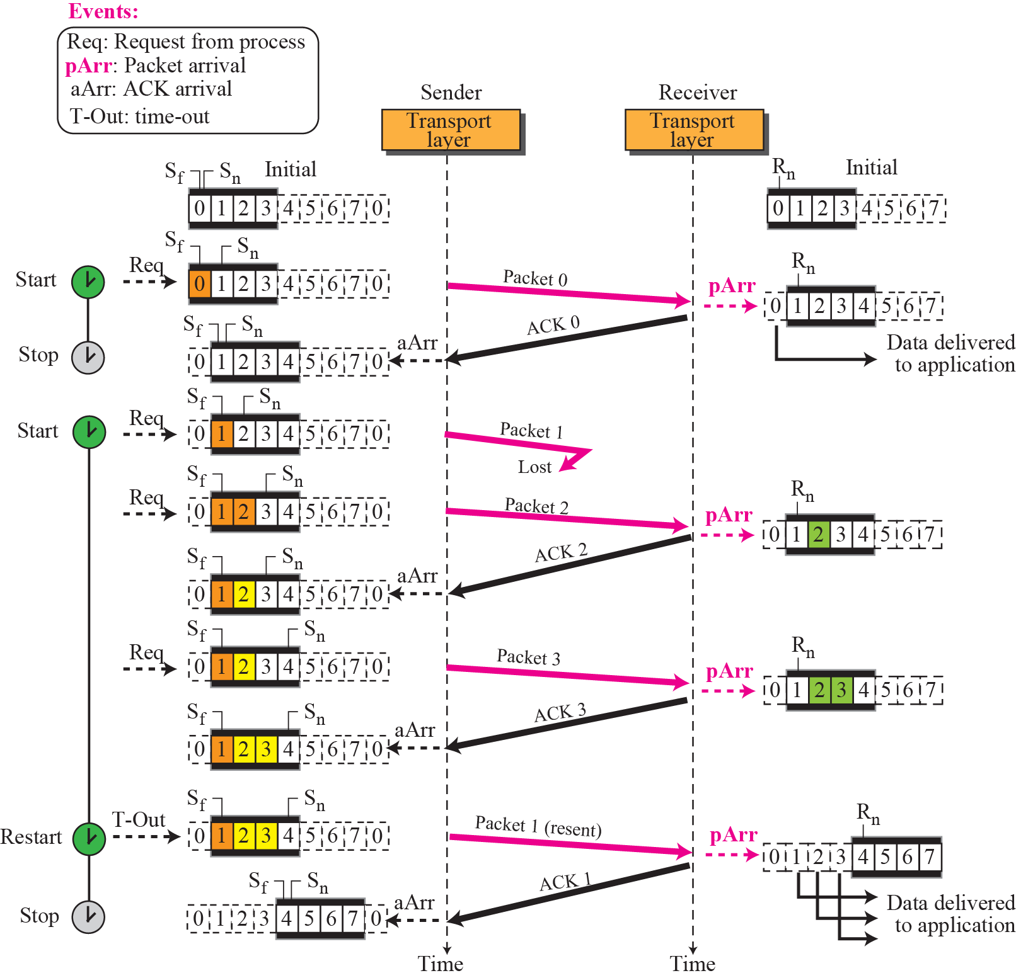
Figure 3.34

Slide 31
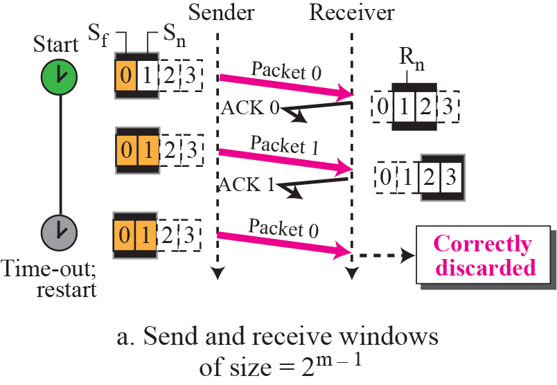
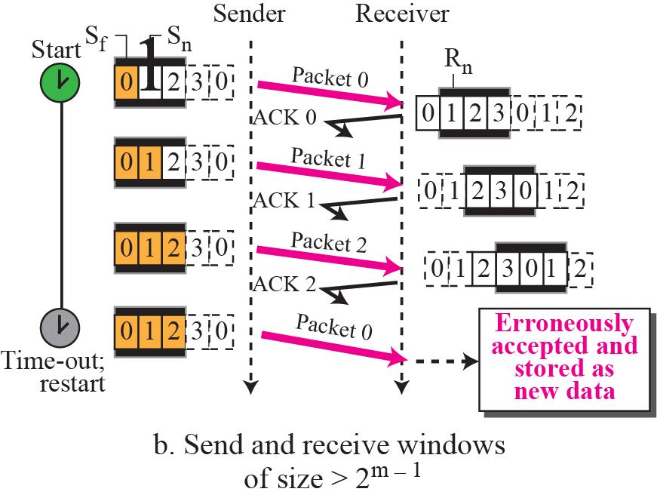
Figure 3.35 Selective-Repeat window size

Slide 32

Note

Slide 33
Bidirectional Protocols: Piggybacking
In real life, data packets are normally flowing in both directions: from client to server and from server to client.
This means that acknowledgments also need to flow in both directions. A technique called piggybacking is used to improve the efficiency of the bidirectional protocols.

Slide 34
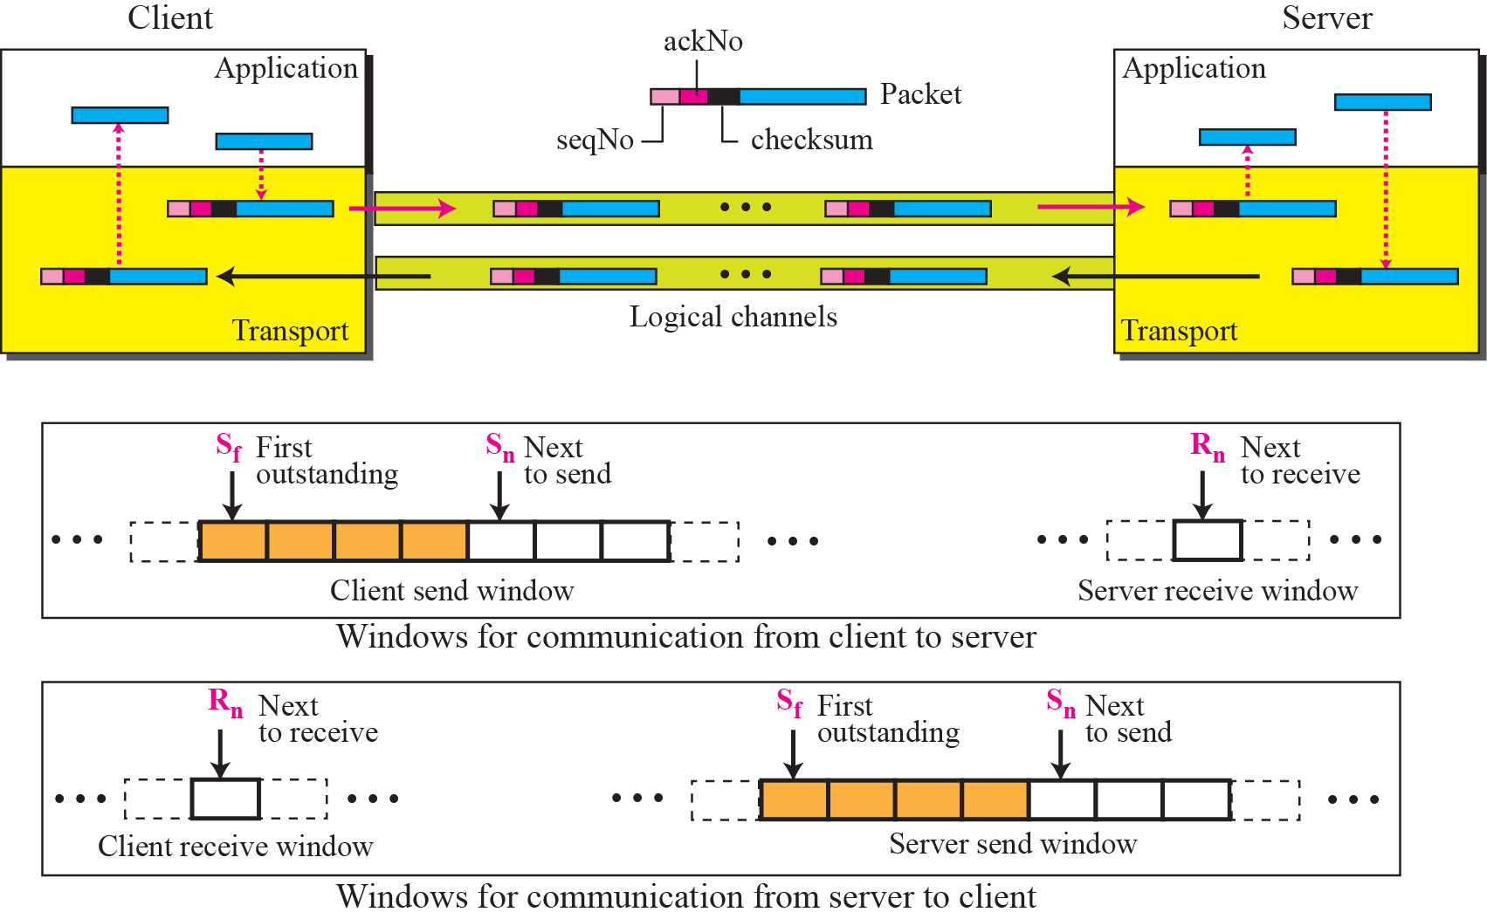
Figure 3.36 Design of piggybacking for Go-Back-N

Slide 35
Example
Assume a sender sends 6 packets: packets 0, 1, 2, 3, 4, and 5. The sender receives an ACK with ackNo = 3. What is the interpretation if the system is using GBN or SR?

Slide 36
Example
Solution
If the system is using GBN, it means that packets 0, 1, and 2 have been received uncorrupted and the receiver is expecting packet 3.
If the system is using SR, it means that packet 3 has been received uncorrupted; the ACK does not say anything about other packets.

